Slide 1



CYBERSECURITY INTERNSHIP PROJECT
Adversary Emulation and Detection Validation: A Purple Team Framework
Moving Beyond Passive Defense
- MR.FUZAIL KHAN
SYS.STATUS: ONLINE // PROTOCOL: ACTIVE // PURPLE_TEAM_LAB_V1.0

Slide 2


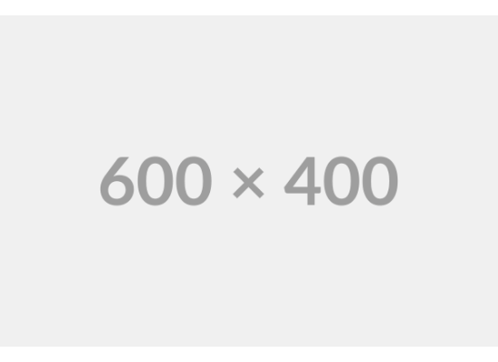
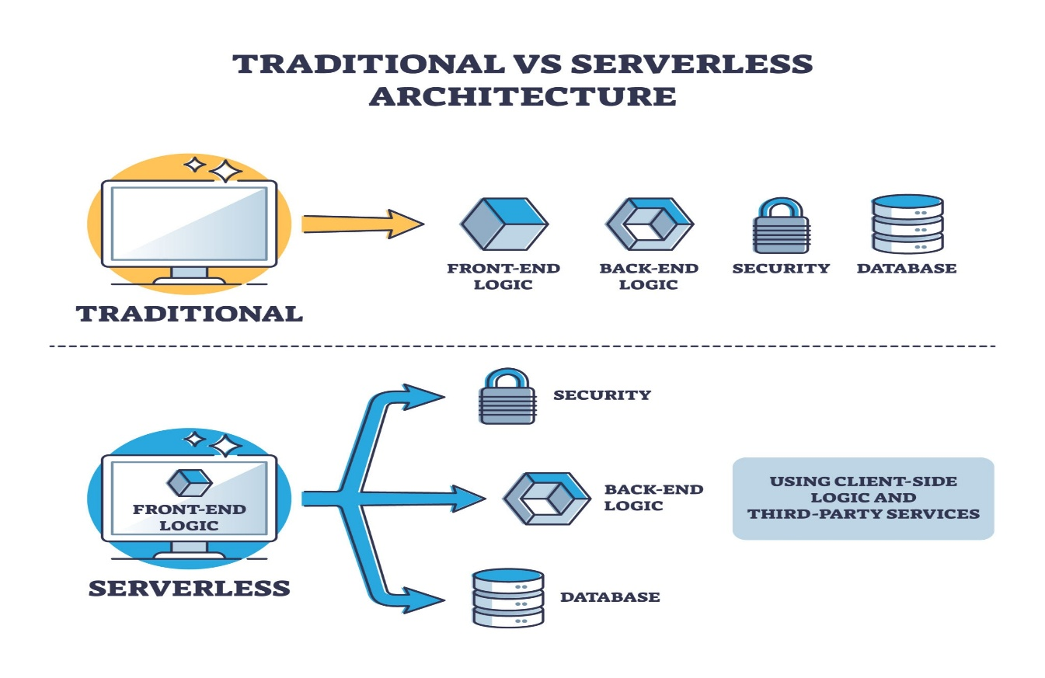
THE PASSIVE DEFENSE TRAP
SCHRÖDINGER'S SIEM
>
Companies spend millions on tools like Wazuh or Splunk.
>
The "Deploy & Forget" fallacy: Tools are installed but rarely tested against real threats.
>
The Reality: You don't know if your detection rules work until you are already breached.
>
Problem: Silence is mistaken for security.

Slide 3







ENTER THE PURPLE TEAM
RED TEAM
BLUE TEAM
PURPLE TEAM
Simulates the adversary. Executes real attack chains using tools like Atomic Red Team.
Defends the network. Analyzes logs, tunes SIEM rules, and responds to incidents.
Collaboration. Feedback loops where attacks inform defense, and defense informs attacks.

Slide 4
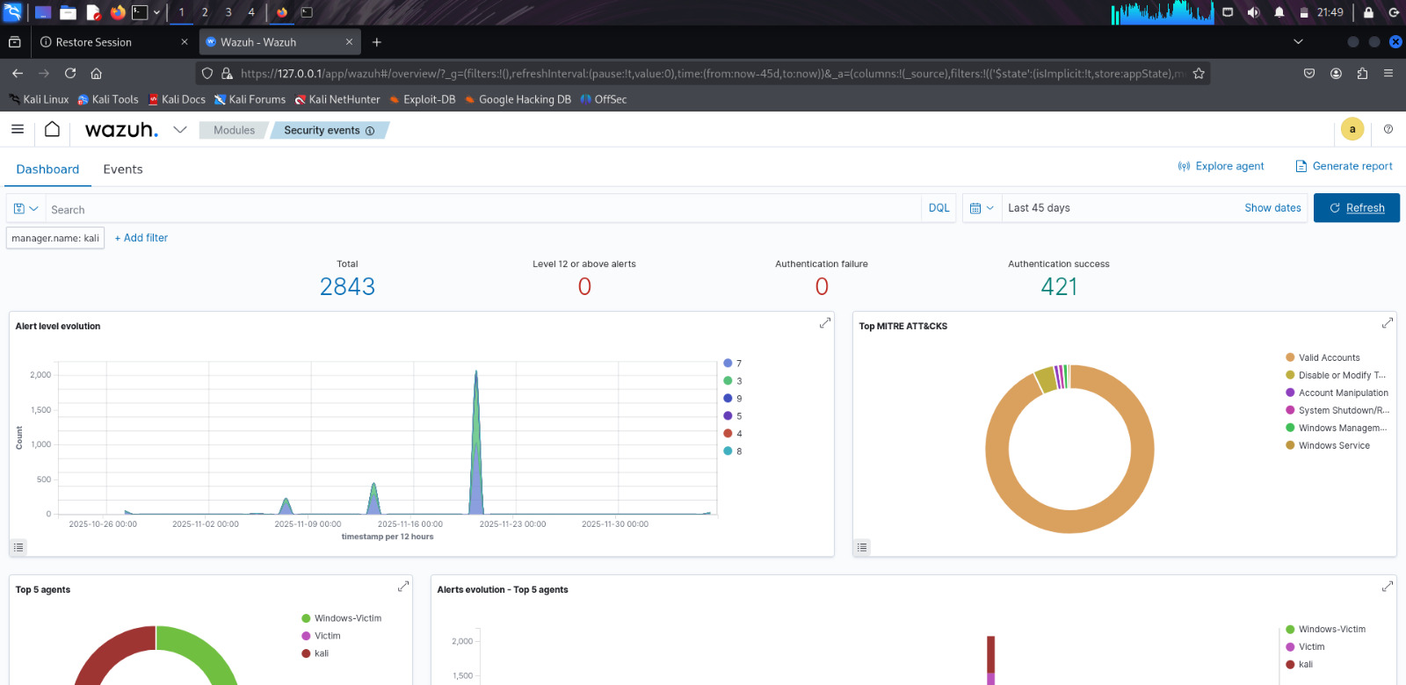

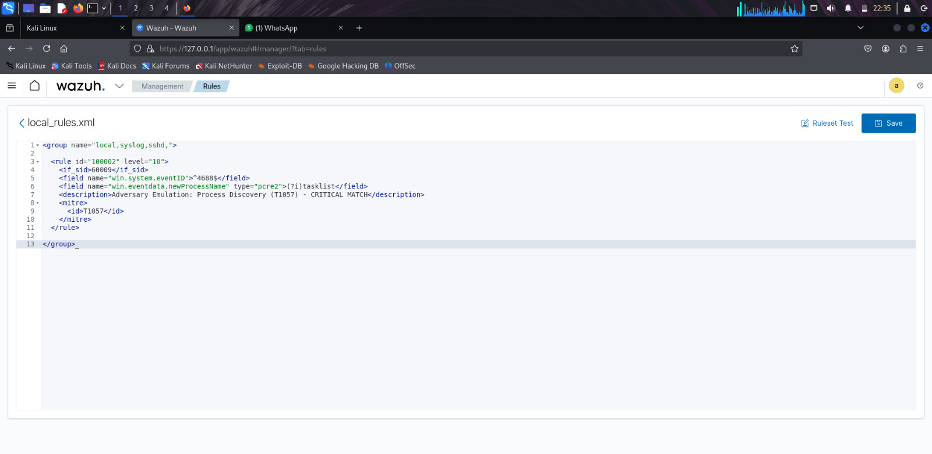
SIMULATING THE ADVERSARY
TARGET: WINDOWS 11
To prove the concept, I built a controlled lab environment to execute three distinct attack cycles.
>
Cycle 1: Discovery Identifying system owners and user privileges (T1033).
>
Cycle 2: Persistence Modifying Registry Run Keys to survive reboots (T1547).
>
Tooling: Atomic Red Team execution framework mapped to MITRE ATT&CK.

Slide 5

REAL-WORLD TROUBLESHOOTING
THE TIMESTAMP BUG
AUDIT BLINDSPOTS
Issue: Logs from the endpoint arrived at the SIEM out of order due to timezone misconfigurations.
Issue: Default Windows Group Policy Object (GPO) does not log the specific Event IDs needed for advanced detection.
Impact: Correlation rules failed to trigger because the "sequence" of events appeared broken.
Impact: The SIEM was blind to the Persistence attacks.
Fix: Tuned Advanced Audit Policy Configuration to enable "Process Creation" and "Registry" auditing.
Fix: Engineered a custom log normalization pipeline to force UTC synchronization.

Slide 6
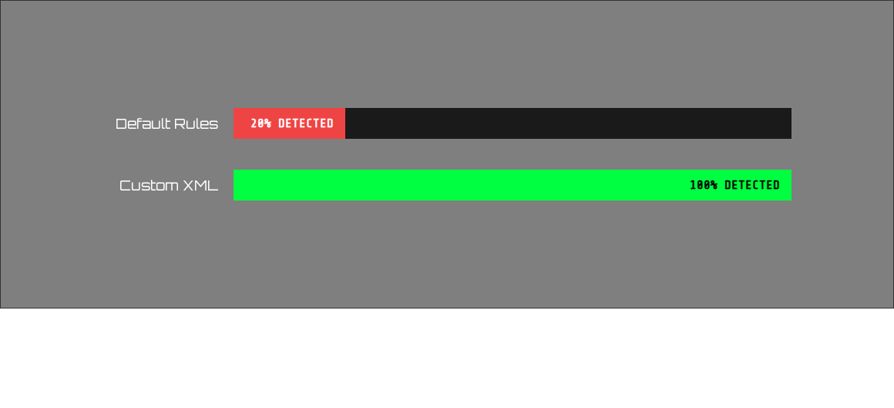
TUNING FOR THE "CROWN JEWELS"
Scenario: LSASS Memory Dumping (T1003). Standard rules missed it entirely. Writing custom XML Decoders was the only way to catch the threat.

Slide 7
FROM PASSIVE TO ACTIVE
3
100%
0
ATTACK CYCLES
DETECTION RATE
FALSE POSITIVES
The lab proved that Configuration > Tool Selection. Passive monitoring is insufficient; active tuning is required to secure the infrastructure.

Slide 8

CONTINUOUS VALIDATION
Security is not a state, it's a process.
Defenses rot over time. We must constantly emulate the adversary to ensure we are ready for the real fight.
AtomicRedTeam LINK
WAZUH(SIEM) LINK
Sigma-Rules LINK
// END_OF_PRESENTATION

